Slide 1
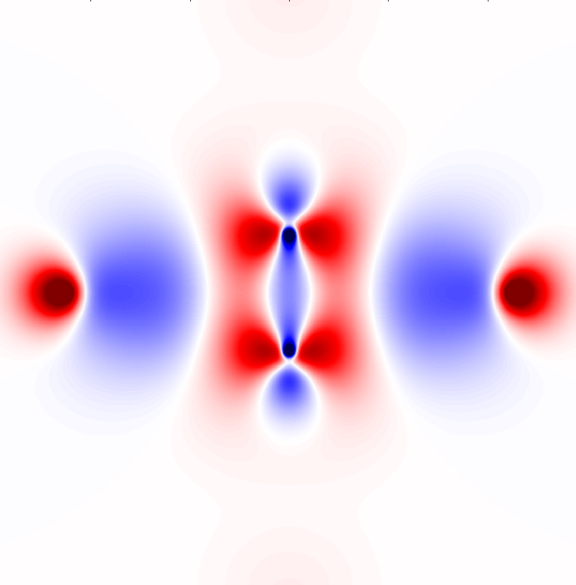
Dec 13, 2015
Investigation of Electronic Effects with Difference Densities
CHENGFEI WANG
Computational and Theoretical Chemistry Group
Department of Chemistry
Southern Methodist University

Slide 2
Overview
Background
Difference density distribution
Calculation of HF densities and
response densities
Introduction
Use Molpro to prepare data
The Scripts and Workflow of Plotting
Gallery: example of C2 pictures
Exercises:(start p31)
Questions: Different Basis Set and Methods

Slide 3
Difference density distribution
Basis set effect:
Molecule A Method 1 basis set 1
Molecule B Method 1 basis set 2
Method effect:
Molecule A Method 1 basis set 1
Molecule B Method 2 basis set 1

Slide 4
Calculation of electron density
The probability of simultaneously finding electron in point (x, y, z) with any spin
For each molecular orbital can be expressed as linear combination of a set of basis functions

Slide 5
Calculation of electron density
Sum over the squared probability-density function of each MO multiplied by the orbital occupation numbers

Slide 6
Calculation of electron density
Density
Density Matrix
MO
BF
MO coefficients
Normalization
Primitives

Slide 7
Calculation of electron density
Coefficients
MO
BF

Slide 8
Response properties
Hamiltonian be corrected by perturbation term
Energy depends on small change
Hellmann-Feynman theorem

Slide 9
HF density and response density
D stands for response density matrix
Nature Orbital includes the response density part (obtained from the diagonalized density matrix)

Slide 10
HF density and response density
First analytical derivative of the energy with regard to the Dirac Delta operator

Slide 11
Workflow of Plotting:
Molpro Cfour Gaussian calculation
Files already prepared for exercises
Result in molden or fchk files
DiffDen.py
Script files kept in the same working directory, start exercise part and only need to do the blue step here
Intermediate data
graphics

Slide 12
Quick guide for DiffDen:
Two Files for difference, first - second
./DiffDen.py job1_polarized.molden job2.molden -j 0.10 -x "-4.0 4.0 0.03" -y "-4.0 4.0 0.03" --p1 "0.0 0.0 0.0" --p2 "1.0 0.0 0.0" --p3 "0.0 1.0 0.0" -d True
DiffDen.py
-j the limits of the value(cut-off)
Intermediate data
graphics

Slide 13
Quick guide for DiffDen:
./DiffDen.py job1_polarized.molden job2.molden -j 0.10 -x "-4.0 4.0 0.03" -y "-4.0 4.0 0.03" --p1 "0.0 0.0 0.0" --p2 "1.0 0.0 0.0" --p3 "0.0 1.0 0.0" -d True
DiffDen.py
The limit of values (cut-off t0 high and to low value)
Intermediate data
graphics

Slide 14
Quick guide for DiffDen:
./DiffDen.py job1_polarized.molden job2.molden -j 0.10 -x "-4.0 4.0 0.03" -y "-4.0 4.0 0.03" --p1 "0.0 0.0 0.0" --p2 "1.0 0.0 0.0" --p3 "0.0 1.0 0.0" -d True
DiffDen.py
The size of the plotting plane, in Bohr unit, 0.03 is the interval
Intermediate data
graphics

Slide 15
Quick guide for DiffDen:
./DiffDen.py job1_polarized.molden job2.molden -j 0.10 -x "-4.0 4.0 0.03" -y "-4.0 4.0 0.03" --p1 "0.0 0.0 0.0" --p2 "1.0 0.0 0.0" --p3 "0.0 1.0 0.0" -d True
DiffDen.py
Three points to determine any plane you want to plot, first as origin, second as x direction of plane, third point help to fix the plane (not necessary to y direction )
Intermediate data
graphics

Slide 16
Quick guide for DiffDen:
./DiffDen.py job1_polarized.molden job2.molden -j 0.10 -x "-4.0 4.0 0.03" -y "-4.0 4.0 0.03" --p1 "0.0 0.0 0.0" --p2 "1.0 0.0 0.0" --p3 "0.0 1.0 0.0" -d True
DiffDen.py
3d surface plot, other option includes contour lines and heatmap
Intermediate data
graphics

Slide 17
Quick guide for DiffDen:
Please see detail guide for each question in exercise part
S
./DiffDen.py job1_polarized.molden job2.molden -j 0.10 -x "-4.0 4.0 0.03" -y "-4.0 4.0 0.03" --p1 "0.0 0.0 0.0" --p2 "1.0 0.0 0.0" --p3 "0.0 1.0 0.0" -d True --load True
DiffDen.py
This option force script start from intermediate data for same job, which saves time (large job takes 10 min to generate data grid)
Intermediate data
graphics

Slide 18
Prepare Data
Use Gaussian to Prepare Data
Note: those files have already prepared for exercises, use them directly to save time. See directories “question 1”, “question 2”… You can skip this part and jump to exercises
Set up density type correctly
by default ( density =scf )use DFT and HF type density. density=cc for any couple-cluster or QCI type density, density=mp2 for mp2 type

Slide 19
Use Gaussian to Prepare Data
2. For post-hf type density (density=scf or mp2) an extra step needed for saving nature orbital into chk file
calculation input 1, save to filename.chk
%Chk=filename.chk
%mem=10gb
#P MP2/6-31g scf=tight pop=full density=MP2
Title name
0 1
…(Geometry information)

Slide 20
Use Gaussian to Prepare Data
2. For post-hf type density (density=scf or mp2) an extra step needed for saving nature orbital into chk file
Calculation input 2, Read from checkpoint file, calculate the nature orbitals and write them back into checkpoint file
%Chk=filename.chk
%mem=10gb
# Guess=(Save,Only,NaturalOrbitals) Geom=AllCheck ChkBasis

Slide 21
Use Gaussian to Prepare Data
3. Information stored in %chk=filename.chk and need to use command to convert
Formchk filename.chk filename.fchk.
Use right version g09 or g03
File we need

Slide 22
Use Cfour to Prepare Data
Set up
PROP=FIRST_ORDER (PROPS=1 have problem)
PRINT=5
2. In /scratch/users/yourname/Cfour/scratch-p1/ found molden_nat
Or s1
File we need

Slide 23
Use Cfour to Prepare Data
3. For our exercise, the
MOLDEN_NAT_CCSDT.molden
MOLDEN_NAT_MP2.molden
Two files have already collected and put in the job5 and job6 folders（job5.molden and job6.molden）

Slide 24
Use Molpro to Prepare Data
Chose NATORB for response density ! And dm in same filename 2352.2
Example of molPro.in
...
{hf;}
{qcisd(t);wf,34,1,0;
natorb,2352.2;dm, 2352.2
}
put,molden,xxx.molden;orb,2352.2;
Wavefunction 34 electrons, sysmmetry type 1, zero net charge
File we need

Slide 25
Use Molpro to Prepare Data
1.Each folder one calculation includes two files
molPro.inp
molPro_jobscript.submit
2.Edit the molPro.inp file and type:
sbatch molPro_jobscript.submit
{hf;} ! Must have hf keywords
{qcisd(t);wf,34,1,0; ! Keword post-HF method
natorb,2352.2;dm, 2352.2
}
put,molden,xxx.molden;orb,2352.2;

Slide 26
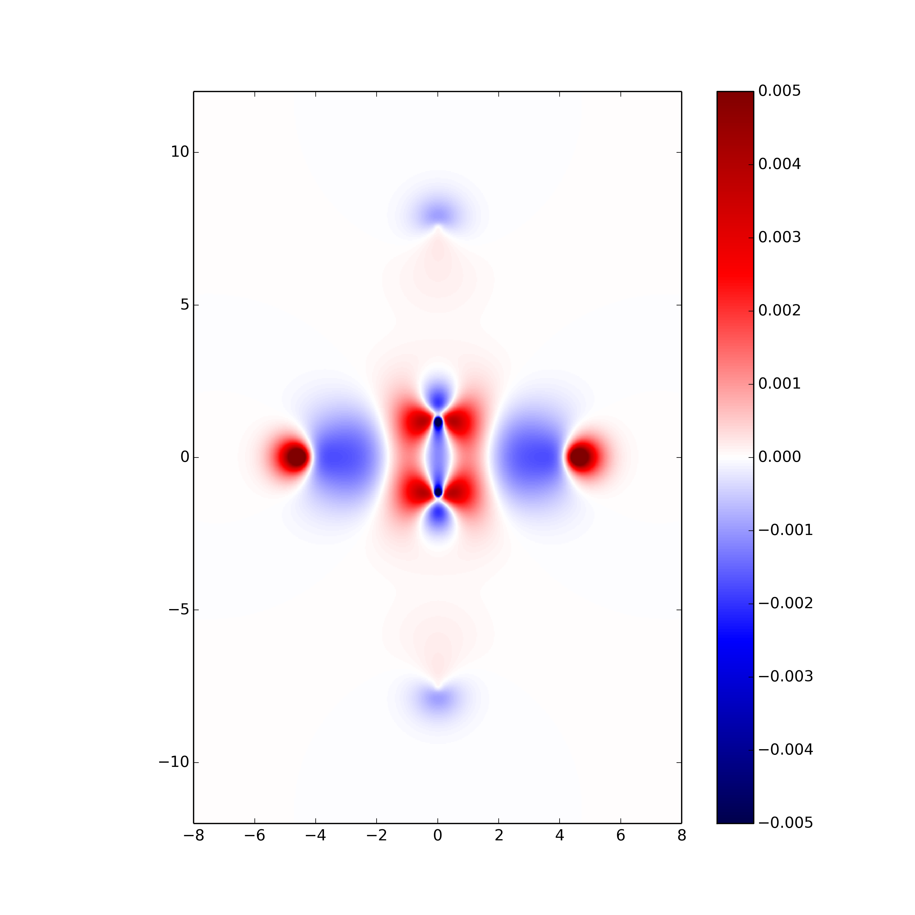
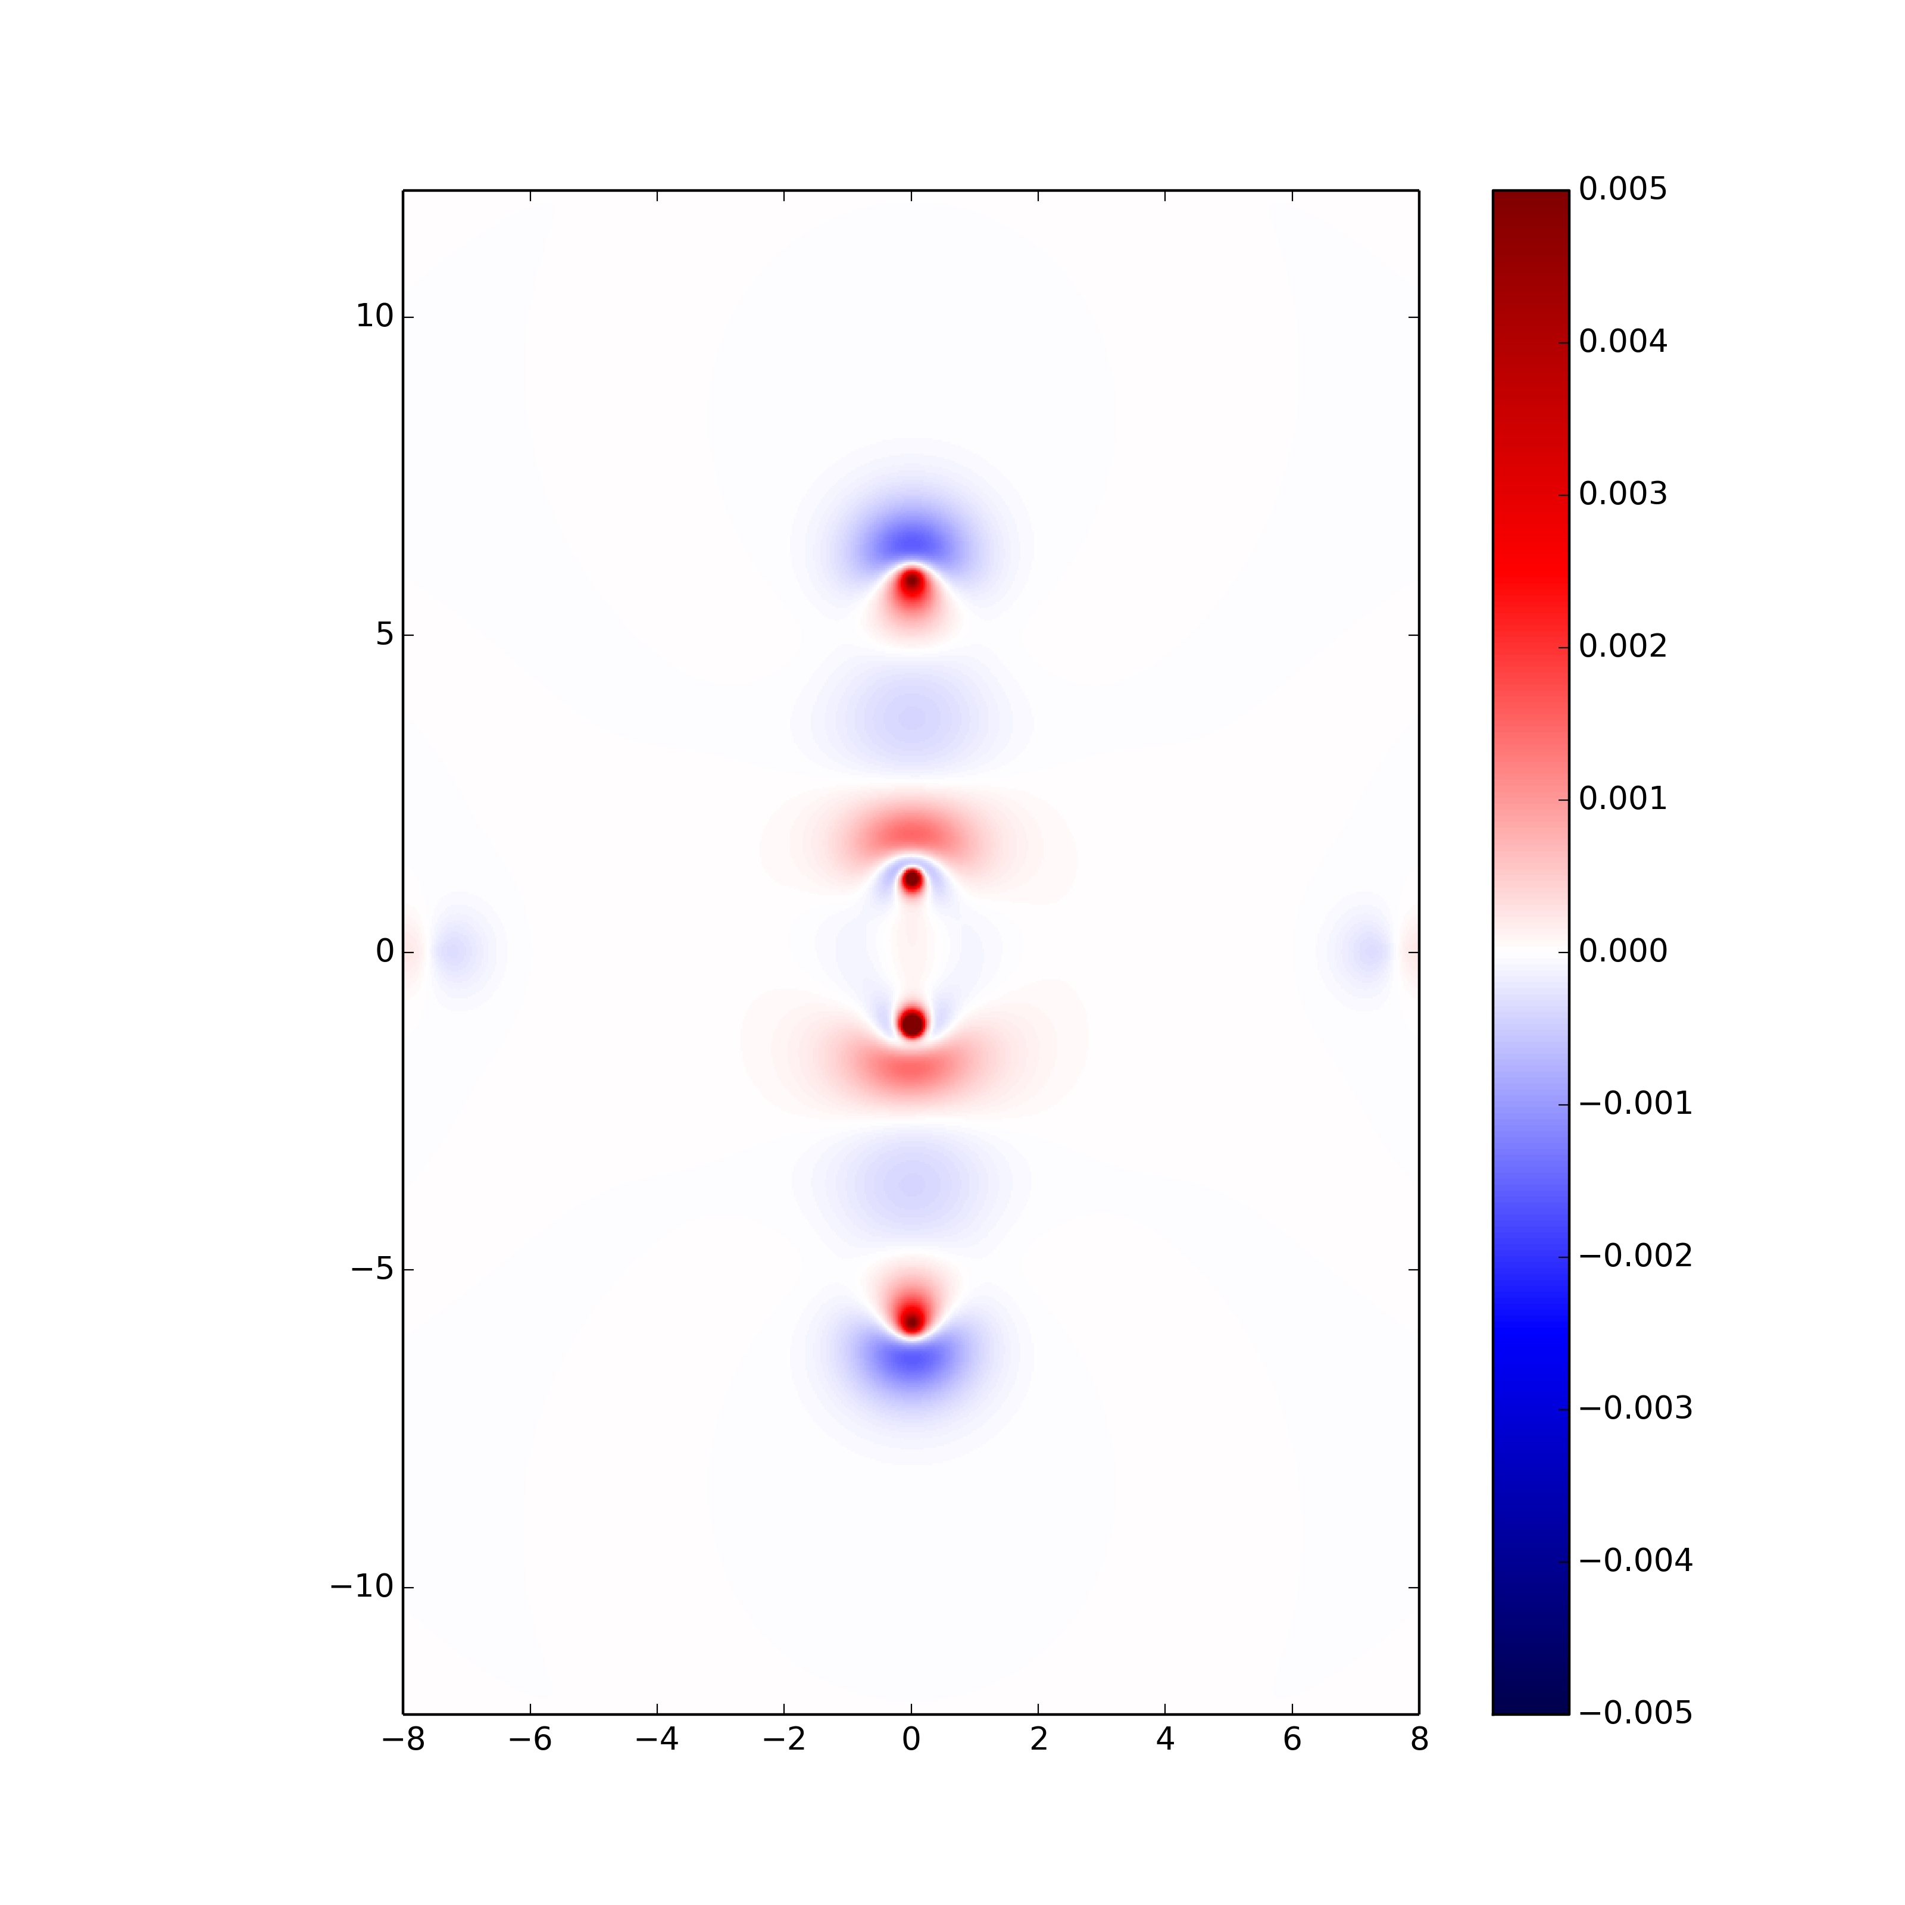
Gallery :Example of C2 pictures
C2 in a He cage: The He atoms reduce the
available spacein x,y- or z-direction
C2-x Confinement
C2-z Confinement

Slide 27
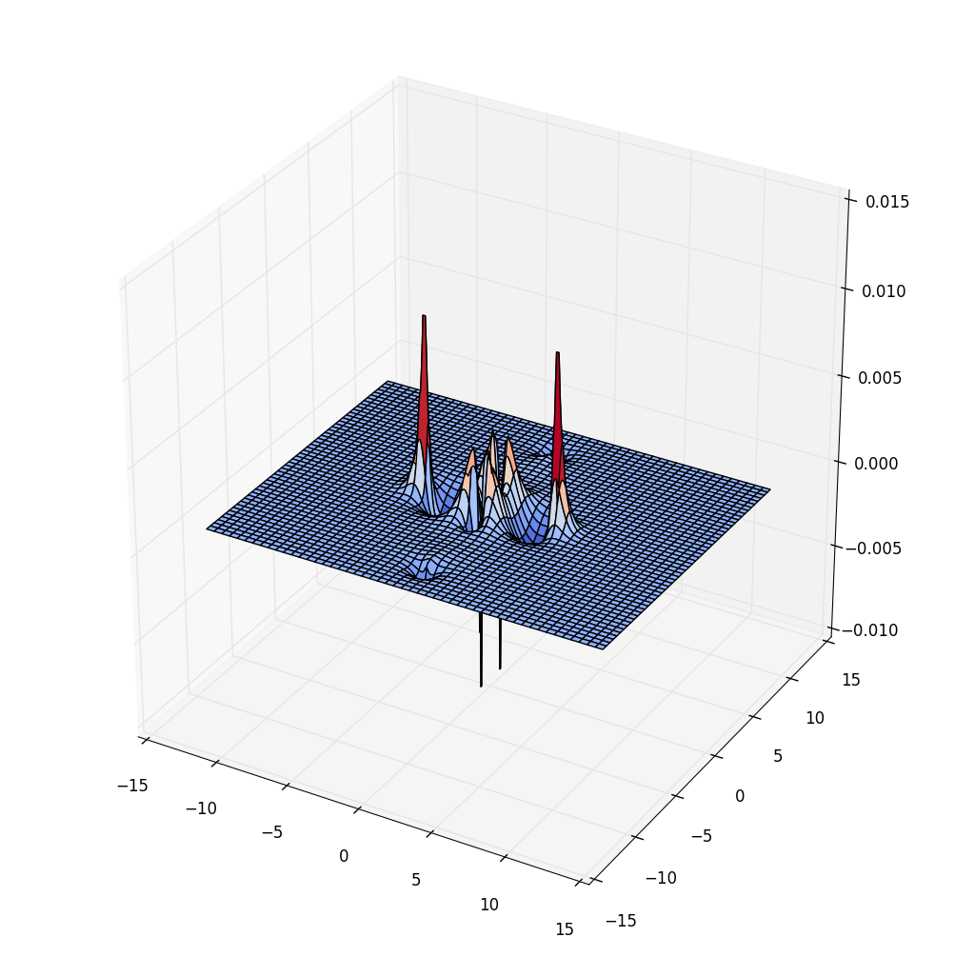
Difference Density
rho(6He+C2) - rho(6He) - rho(C2)
C2-x Confinement
3d

Slide 28
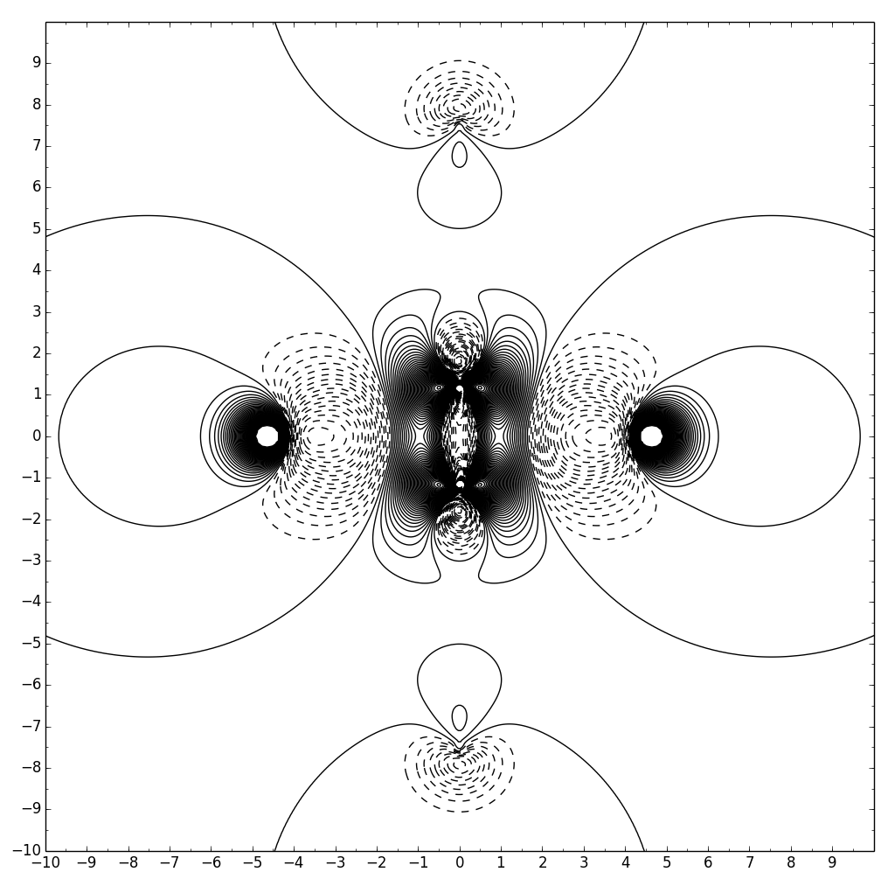
Difference Density
rho(6He+C2) - rho(6He) - rho(C2)
C2-x Confinement
Black and white

Slide 29
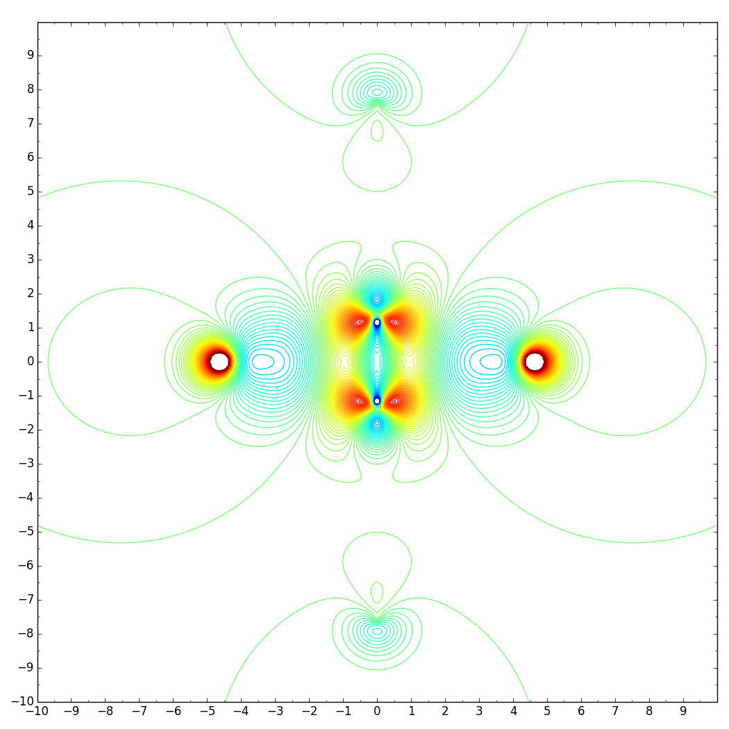
Difference Density
rho(6He+C2) - rho(6He) - rho(C2)
C2-x Confinement
Colour

Slide 30
Some suggestion
*Better begin with the 3d graphics
*Chose parameters carefully to get good picture 0.03~0.04 intervals and chose –j cut-off carefully
*The distance unit is Bohr, 1 Bohr = 1.88973 Anstrom

Slide 31
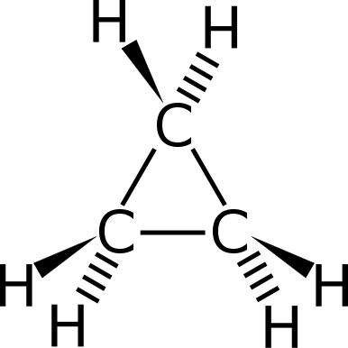
Exercises
Question 1: Different Basis Set
Calculate two cyclopropanes single point energy, use same geometry and method (HF) for both, but one with 6-31g and another with 6-31g**, discuss why.

Slide 32
cd to the directory question 1 and copy those command into terminal
# generate 3d.png
./DiffDen.py job1_polarized.molden job2.molden -j 0.10 -x "-4.0 4.0 0.03" -y "-4.0 4.0 0.03" --p1 "0.0 0.0 0.0" --p2 "1.0 0.0 0.0" --p3 "0.0 1.0 0.0" -d True
# generate 3d.png <-this # line is comment do not copy
Those command can be found in file command.txt in each directory

Slide 33
cd to the directory question 1 and copy those command into terminal
# generate heatmap.png
./DiffDen.py job1_polarized.molden job2.molden -j 0.10 -x "-4.0 4.0 0.03" -y "-4.0 4.0 0.03" --p1 "0.0 0.0 0.0" --p2 "1.0 0.0 0.0" --p3 "0.0 1.0 0.0” --load True --heatmap True
# generate contours.png
./DiffDen.py job1_polarized.molden job2.molden -j 0.10 -x "-4.0 4.0 0.03" -y "-4.0 4.0 0.03" --p1 "0.0 0.0 0.0" --p2 "1.0 0.0 0.0" --p3 "0.0 1.0 0.0” --load True --l 50 -n “25 8”
--heatmap True This is a heatmap option
--l 50 -n “25 8” The l means 50 levels will the values be divided into and plot 25 contour lines above zero and 8 below zero so avoid too much contour lines packed in peak area

Slide 34
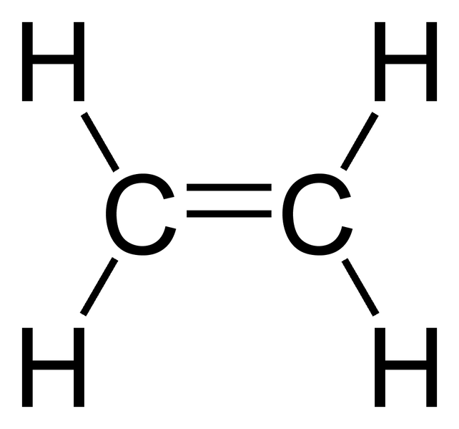
Question 2: Different Method
Calculate two ethylene single point energy, use same geometry and basis set (6-31g**) for both, but one with HF and another with MP2. Try to explain difference density from correlation aspect.

Slide 35
cd to the directory question 2 and copy those command into terminal
# generate 3d.png
./DiffDen.py job4_mp2.molden job3_hf.molden -j 0.025 -x "-4.0 4.0 0.03" -y "-4.0 4.0 0.03" --p1 "0.0 0.0 0.0" --p2 "1.0 0.0 0.0" --p3 "0.0 1.0 0.0" -d True
# generate heatmap.png
./DiffDen.py job4_mp2.molden job3_hf.molden -j 0.025 -x "-4.0 4.0 0.03" -y "-4.0 4.0 0.03" --p1 "0.0 0.0 0.0" --p2 "1.0 0.0 0.0" --p3 "0.0 1.0 0.0” --load True --heatmap True
# generate contours.png
./DiffDen.py job4_mp2.molden job3_hf.molden -j 0.025 -x "-4.0 4.0 0.03" -y "-4.0 4.0 0.03" --p1 "0.0 0.0 0.0" --p2 "1.0 0.0 0.0" --p3 "0.0 1.0 0.0” --load True --l 20 -n “10,10”

Slide 36
Question 3: More Different Method
Calculate two single point energy, use same geometry and basis set (cc-pVTZ) for both, but one with MP2 and another with CCSD(T), in CFOUR
Because CCSD(T ) only works in 2015 version molpro and cfour
the plot has to be made in a OOF plane

Slide 37
cd to the directory question 3 and copy those command into terminal
# generate 3d.png
./DiffDen.py job5_ccsdt.molden job6_mp2.molden -j 0.005 -x "-6.0 6.0 0.05" -y "-6.0 8.0 0.05" --p1 "0.0 0.0 2.02022585638" --p2 "-1.37513850734 -1.74434977673 2.02022585638" --p3 "0.381784167486 -5.28964990087 -1.70084505159" -d True
# generate heatmap.png
./DiffDen.py job5_ccsdt.molden job6_mp2.molden -j 0.005 -x “-6.0 6.0 0.05” -y “-6.0 8.0 0.05” --p1 “0.0 0.0 2.02022585638” --p2 “-1.37513850734 -1.74434977673 2.02022585638” --p3 “0.381784167486 -5.28964990087 -1.70084505159” --load True --heatmap True

Slide 38
cd to the directory question 3 and copy those command into terminal
# generate contours.png
./DiffDen.py job5_ccsdt.molden job6_mp2.molden -j 0.005 -x "-6.0 6.0 0.05" -y "-6.0 8.0 0.05" --p1 "0.0 0.0 2.02022585638" --p2 "-1.37513850734 -1.74434977673 2.02022585638" --p3 "0.381784167486 -5.28964990087 -1.70084505159” --load True --l 20 -n “15,10”

Slide 39
Question 4: Compare a non-relativistic (HF)
and a relativistic density (NESC-HF)
Calculate Au-H in HF with nesc and without nesc to see the relativistic effect
(see Xun’s talk how to calculate)

Slide 40
cd to the directory question 4 and copy those command into terminal
# generate 3d.png
./DiffDen.py job7.fchk job8_no.fchk -j 0.05 -x "-4.0 4.0 0.03" -y "-6.0 6.0 0.03" --p1 "0.0 0.0 0.0" --p2 "1.0 0.0 0.0" --p3 "0.0 0.0 1.0" -d True
# generate heatmap.png
./DiffDen.py job7.fchk job8_no.fchk -j 0.05 -x "-4.0 4.0 0.03" -y "-6.0 6.0 0.03" --p1 "0.0 0.0 0.0" --p2 "1.0 0.0 0.0" --p3 "0.0 0.0 1.0” --load True --heatmap True

Slide 41
cd to the directory question 4 and copy those command into terminal
# generate contours.png
./DiffDen.py job7.fchk job8_no.fchk -j 0.05 -x "-4.0 4.0 0.03" -y "-6.0 6.0 0.03" --p1 "0.0 0.0 0.0" --p2 "1.0 0.0 0.0" --p3 "0.0 0.0 1.0” --load True --l 20 -n “20 20”

Slide 42
Paper 110 of the CATCO list
Paper 119, Section 5.1
Paper 357 NESC method

Slide 43
Appendix I:
Answers of the four questions

Slide 44
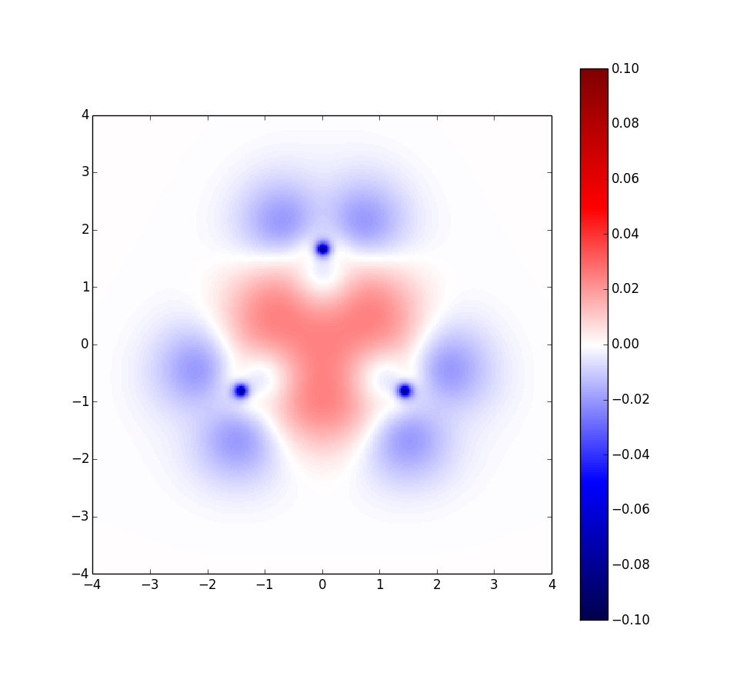
Question 1: Different Basis Set

Slide 45
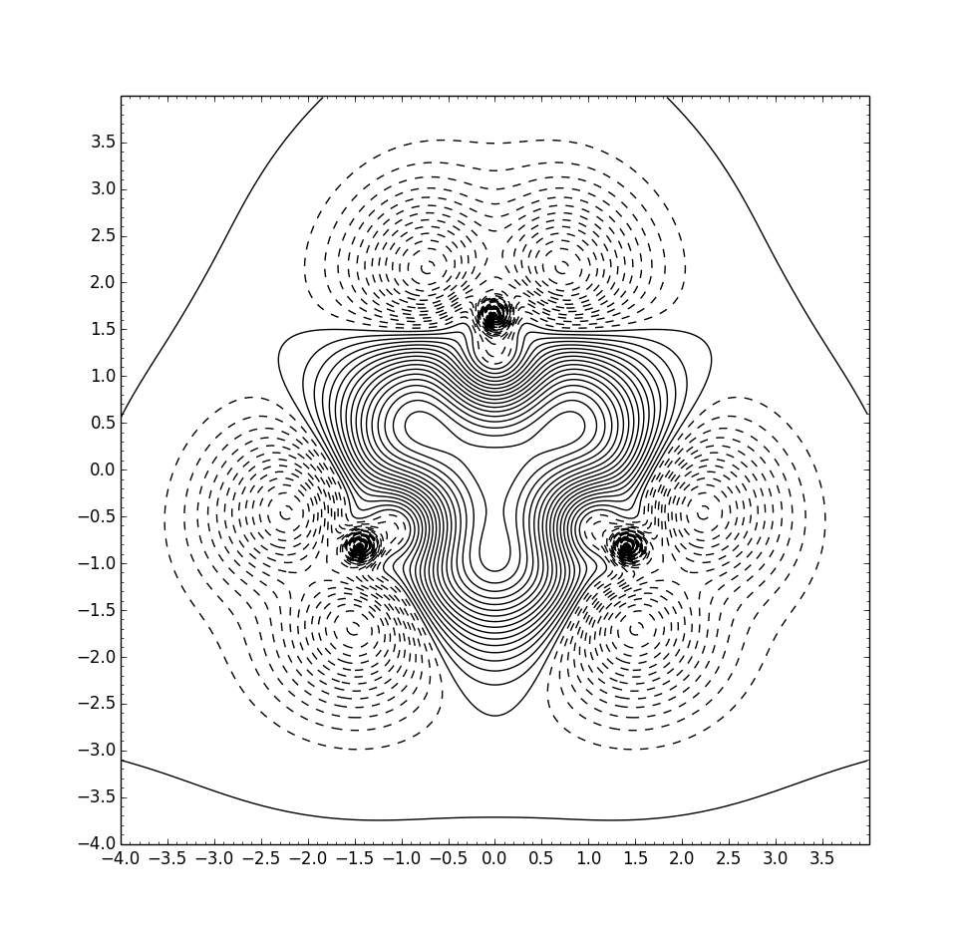
Question 1: Different Basis Set

Slide 46
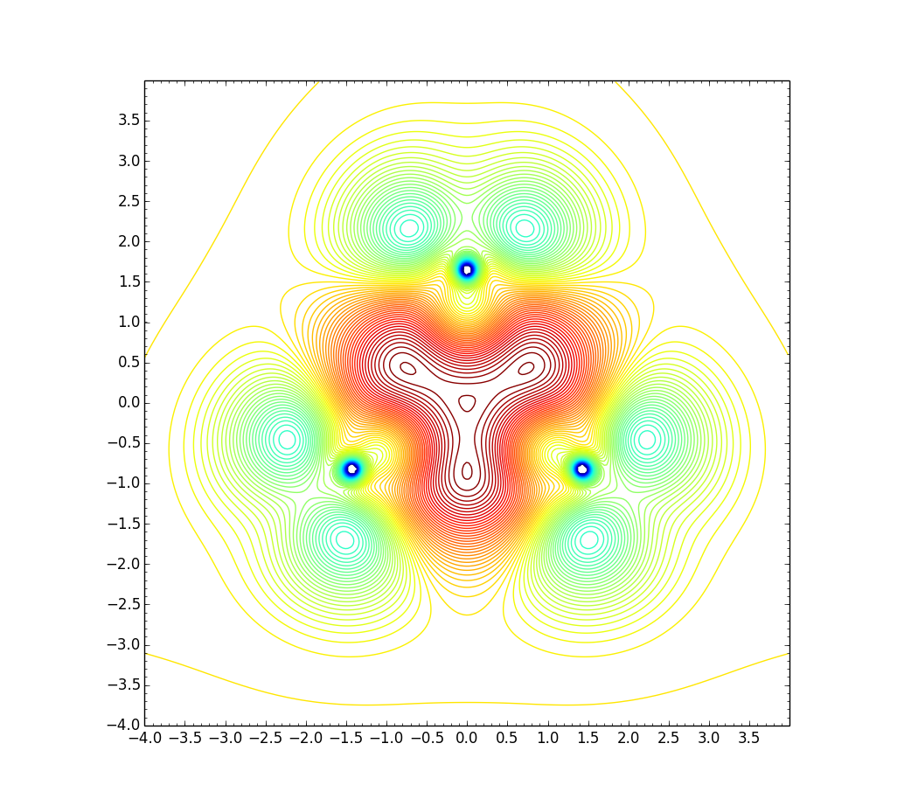
Question 1: Different Basis Set

Slide 47
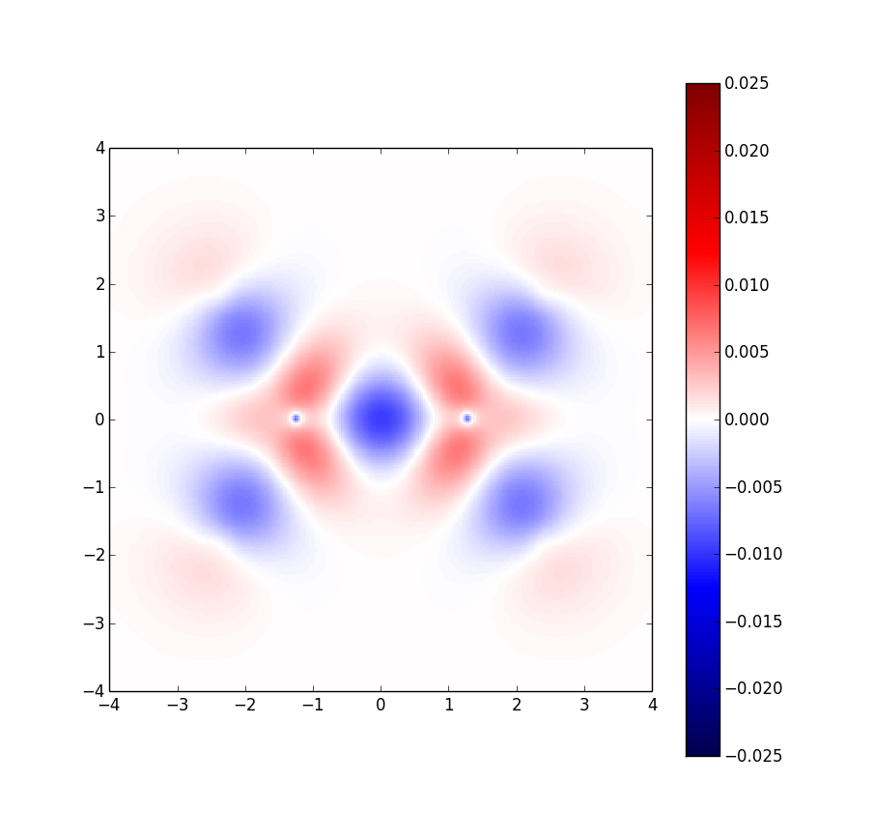
Question 2: Different Method

Slide 48
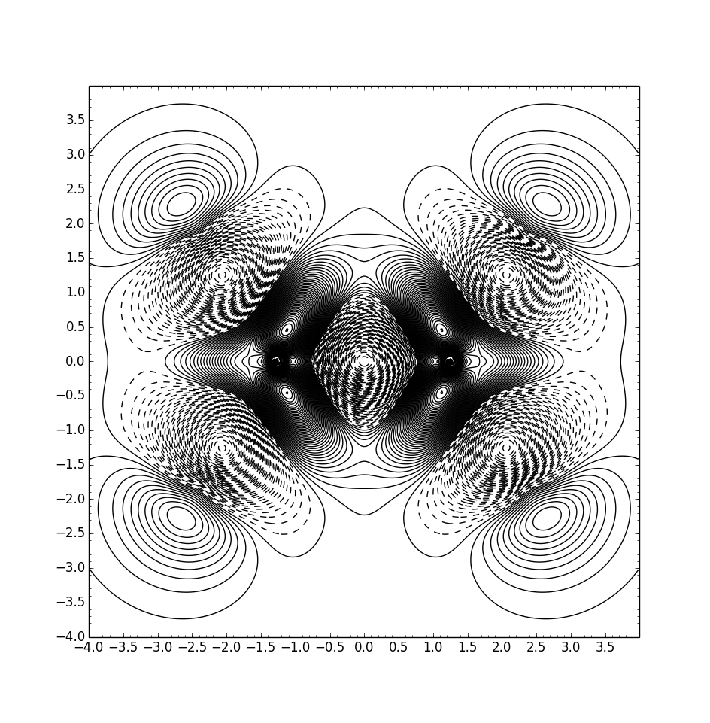
Question 2: Different Method

Slide 49
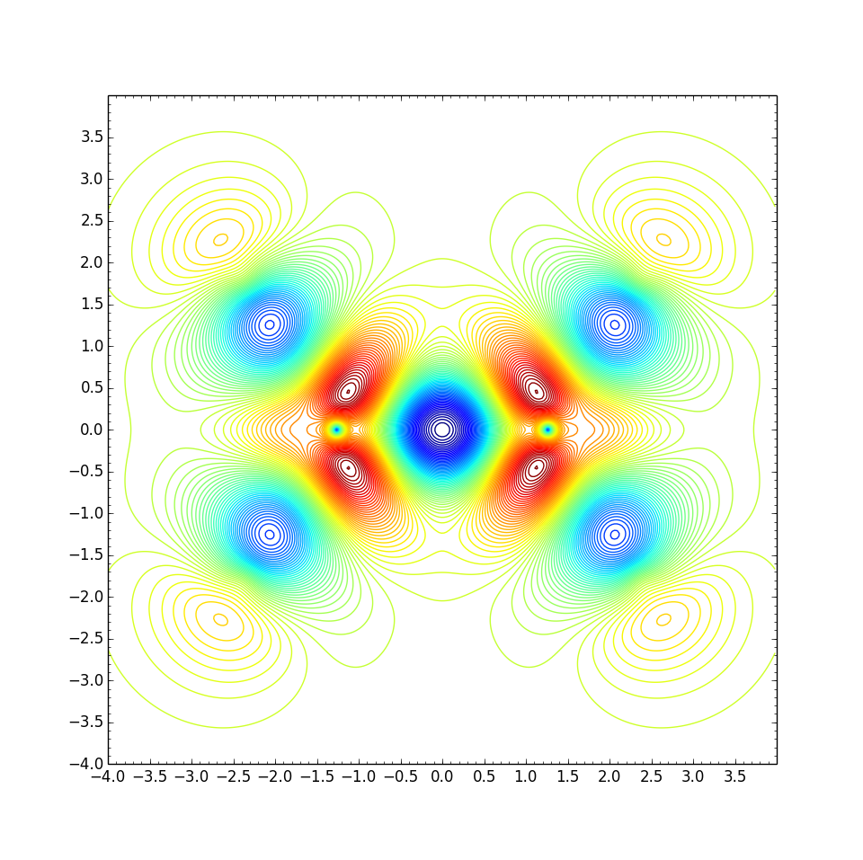
Question 2: Different Method

Slide 50
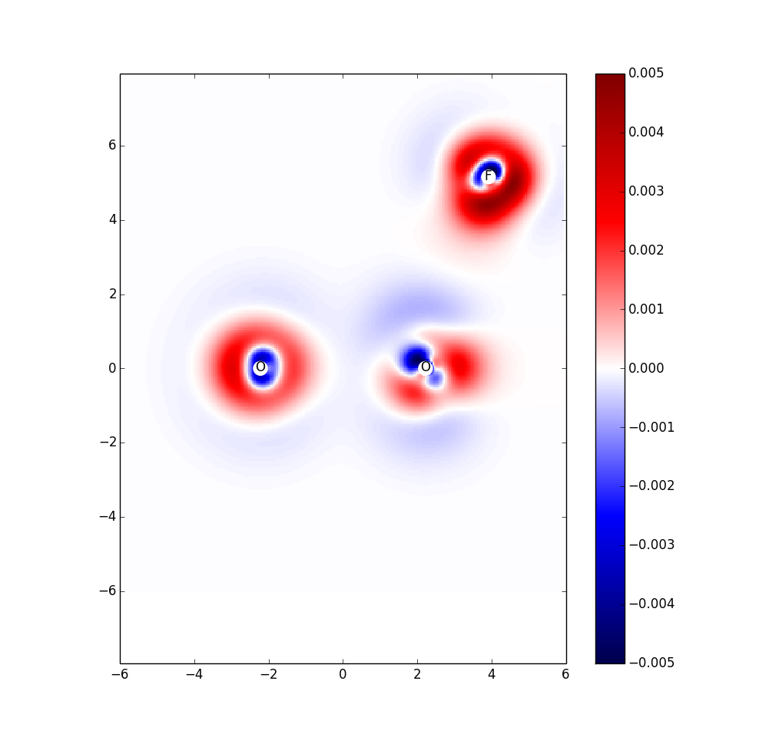
Question 3: Different Method ccsdt

Slide 51
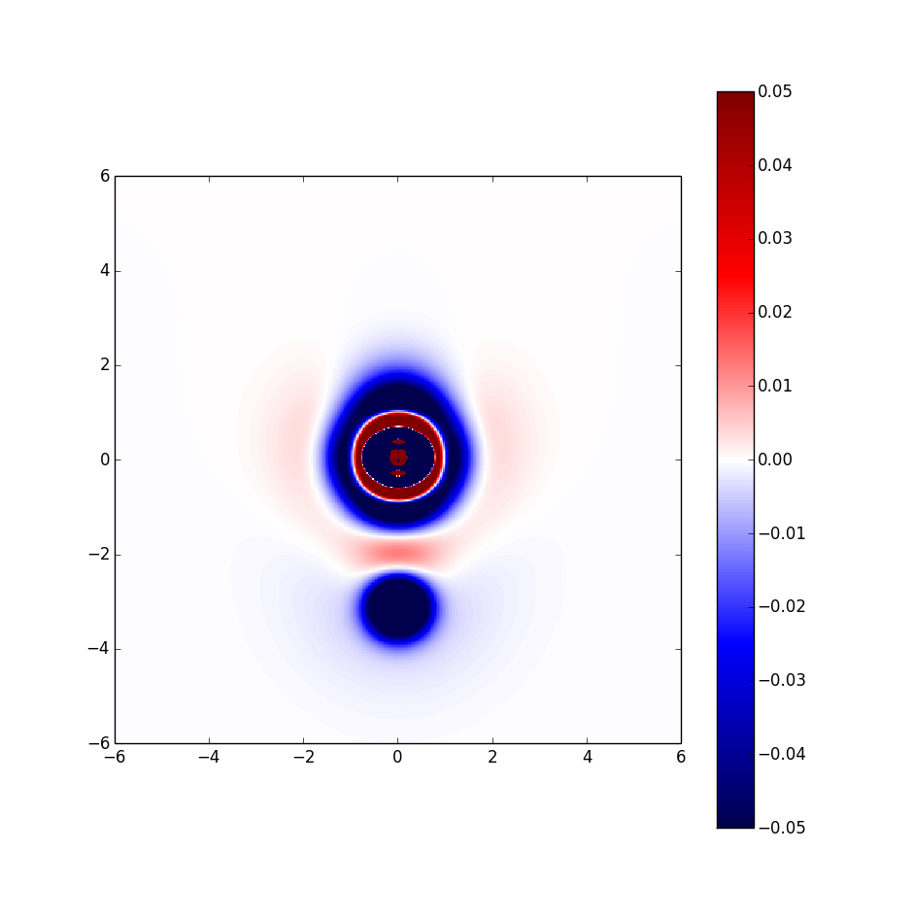
Question 4: non-relvitistic effect

Slide 52
Appendix II:
The old version of density plot package

Slide 53
(old version) workflow of Plotting: (obsolete)
Molden files
generate_density.py
A.data, B.data …many files
2. operate_density.py
A-B.data file
3. plot_density.py or heat_density
graphics

Slide 54
Workflow of Plotting
generate_density.py
./generate_density.py A.molden -x '-5.0 5.0 0.1' -z '-5.0 5.0 0.1' -y '0.0’
./generate_density.py B.molden -x '-5.0 5.0 0.1' -z '-5.0 5.0 0.1' -y '0.0’
./generate_density.py A_B.molden -x '-5.0 5.0 0.1' -z '-5.0 5.0 0.1' -y '0.0'
x-start, x-end, interval(if smaller than 0.03 will very slow)
Cut the plane at xz which is y=0.0
Script will generate xxx.data files

Slide 55
Workflow of Plotting
2. operate_density.py
Store intermediate result
Operate +-*/ on two objects
./operate_density.py A_B.data -o "-" -i A.data -f tmp.data
./operate_density.py tmp.data -o "-" -i B.data -f AB_A_B.data
Complicate calculation can be done step by step using tmp files
AB-A-B density difference

Slide 56
Workflow of Plotting
3. plot_density.py or heat_density
-d True get 3d graphic always good idea begin with 3d to have full picture
-j means cut-off max value, should set large first
-t tick marks
./plot_density.py AB_A_B.data -j 0.01 -d True
or
./plot_density.py AB_A_B.data -j 0.01 -n 150 -t "0.1 0.5”
or
./plot_density.py AB_A_B.data -j 0.01 -n 150 -t "0.1 0.5" -k True
Number of contour lines
Get color picture

Slide 57
Workflow of Plotting
3. plot_density.py or heat_density
./heat_density.py n2-x.data -j 0.005 --heatmap True
heatmap keywords
heatmap keywords

